Slide 1
joint
韩红雷
中国传媒大学 动画学院

Slide 2
以往课程回顾
物理仿真基础
物理仿真程序基础
  电子游戏游戏程序的特点
  仿真程序的组成元素
  物理仿真和渲染的关系
刚体物理仿真
  刚体运动的特点
  刚体物理仿真的知识点
    基本形状、休眠、物理材质、冻结、阻尼、CCD碰撞检测。。

Slide 3
本课知识点
Joint的概念及特点
Joint的类型
如何使用Joint
Joint的主要使用场合
上机练习

Slide 4
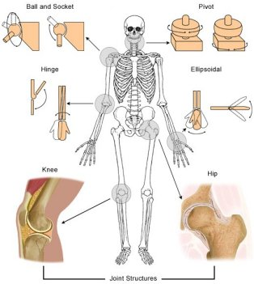
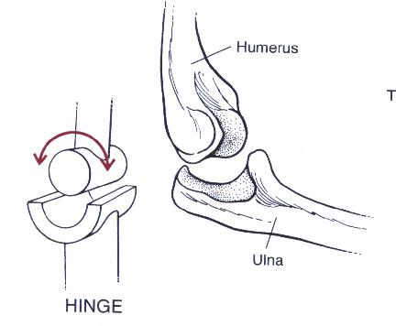
什么是joint
A joint is the location at which two or more bones make contact.
Notes:
维基的解释

Slide 5
物理仿真中的Joint
用来模拟现实世界中的关节结构
  Joint是一个宽泛的概念
  泛指用来连接不同物体的一种结构
Joint是“约束”的一种
  约束body的运动

Slide 6
Joint的作用
如果没有Joint，actor的运动丰富度将降低
可以让连接的两个actor运动受到对方影响
他们之间受限的运动决定于Joint的类型
  后面会介绍到不同类型joint的特点
讨论：
  大家玩过的游戏中那些地方使用到了Joint？
Notes:
Without joints or shapes, actors would be able to do little else but float through space. Joints provide a consistent way to connect two actors. They require that the two actors always move relative to each other. The specific way in which they limit movement is determined by the type of joint.
Joints and contacts (see Collision Detection) are both called constraints because they constrain the motion of a body. The SDK only supports pairs of constraints. In other words, each joint or contact is between exactly two actors. One of these actors may be the implicit world actor, which represents the immovable global reference frame. To specify a joint between an actor and the world, pass NULL as one of the two actor pointers when you create the joint. The actor which is not NULL must be dynamic, as connecting two static actors, implicitly immobile, would be pointless.

Slide 7
Joint的特点
PhysX只支持一对约束
  每个joint只能连接两个actor
Joint连接的两个actor满足的条件
  如果将一个actor和“世界”连接，则将其中一个actor指针设定为“NULL”
  不能用Joint来连接两个static actor
    Joint是约束运动，连接两个不动的物体没意义
    可以使用多shape来实现
Notes:
Joints and contacts (see Collision Detection) are both called constraints because they constrain the motion of a body. The SDK only supports pairs of constraints. In other words, each joint or contact is between exactly two actors. One of these actors may be the implicit world actor, which represents the immovable global reference frame. To specify a joint between an actor and the world, pass NULL as one of the two actor pointers when you create the joint. The actor which is not NULL must be dynamic, as connecting two static actors, implicitly immobile, would be pointless.

Slide 8
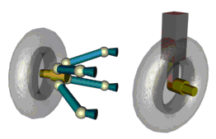
Joint的建模
如何模拟现实世界的机器
  直接按照现实世界的样子建模
  进行合理简化
  比如：汽车减震器（或悬挂系统）在现实生活中无法穿过轮子，所以需要做一系列复杂结构；而用计算机模拟则不必
Notes:
When considering an appropriate joint from which to model a real world machine, making an exact copy may be possible, but is almost never the optimal choice. This is because engineers who design real world objects have constraints you do not have within a simulation. For example, shock absorber elements in the real world cannot go through the wheel which they support - for this reason the engineer has to use additional joints to lead the suspension mechanism around the wheel. In a virtual simulation, this is not a consideration.
Also in the real world, an asymmetric construction may be impractical because it might lead to added friction or less stability. In the simulation, you don't have friction unless you purposely create it. Similarly, a real world car that has twice as many shock absorbers as another will not necessarily be slower, but your simulation of it will.
Consider the picture below of a real world car suspension assembly versus a virtual approximation. They are quite different. The real thing looks much more "realistic". For this reason, it may be useful to create the real assembly as a graphical prop, displayed and animated in place of the simplified dynamics scheme that you use for the actual simulation.
The figure shows a real mechanical component (single wheel suspension of a car) made up of a large number of joints, and an alternative simpler scheme with about the same degrees of freedom.

Slide 9
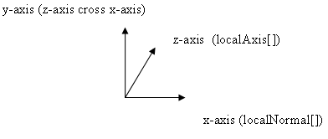
Joint的局部坐标
每个actor具有与其坐标系有关的Joint坐标系
  除了6DOF Joint外都是左手坐标系
NxVec3 localNormal[2];
NxVec3 localAxis[2];
NxVec3 localAnchor[2];
Notes:
In the SDK, all joint types share some common properties which are collected in the NxJoint class and the corresponding descriptor NxJointDesc. First, they all have two actor pointers. Each of the actors, including the implicit world actor represented by a NULL actor pointer, have a joint frame that is specified relative to its actor frame. The two frames are stored in NxJointDesc as two basis vectors and a point, shown below:
NxVec3 localNormal[2];
NxVec3 localAxis[2];
NxVec3 localAnchor[2];
The axis convention for joint frames follows a left-handed rule, differing from the world frame convention which uses a right-handed rule.
The 6 DOF joint is an exception, using a right-handed convention as shown below:

Slide 10
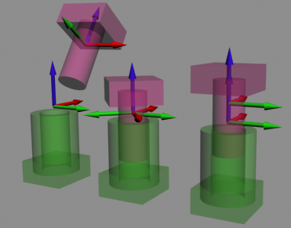
图示
左边那个图有错误
  柱形joint，但两个actor的坐标系不对应
Notes:
These two frames uniquely identify the geometric placement of the joint within the simulation. They never change because they are fixed relative to the respective actors; however, the frames can end up in different places. The joint moves when the connected actors move, therefore these frames, when transformed to the world space via the actor's transform, also move. The image below shows joint frames for a cylindrical joint. In the far left configuration, the blue z axis of the frames does not match up, meaning that this configuration suffers from significant joint error. The other two configurations are permissible.

Slide 11
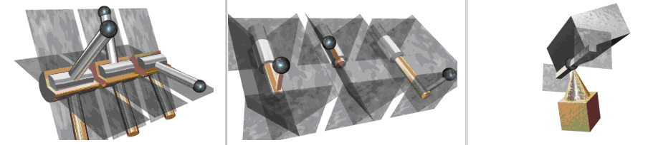
Joint Limits
Hinge joint with limits, and the resulting two extreme positions. The blue sphere is the 'limit point', and moves with the silver actor. The planes move with the gold actor.
Slider joint with four limit planes, and two possible extreme positions. The planes are specified to move with the silver actor.
The point on line joint is limited by two planes which move with the silver actor.

Slide 12
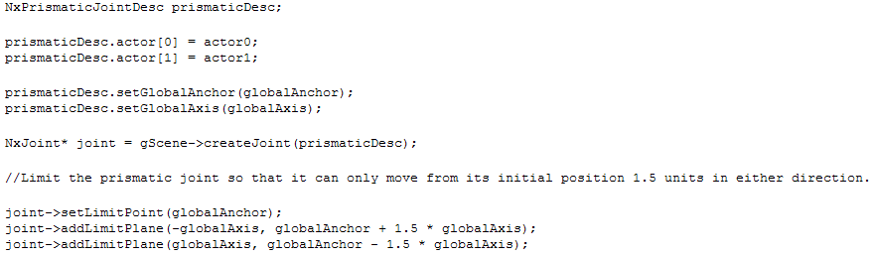
如何设置
void NxJoint::setLimitPoint(const NxVec3 & point, bool pointIsOnBody2 = true);
bool NxJoint::addLimitPlane(const NxVec3 & normal, const NxVec3 & pointInPlane);

Slide 13
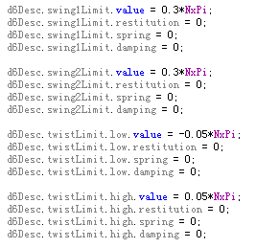
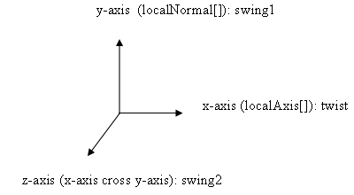
其他设置方式

Slide 14

Breakable Joints
通过设置NxJointDesc的maxForce和 maxTorque可以将Joint设置为可破坏类型
NxJoint::setBreakable()可以改变这个设置
Notes:
Joints can be set to be breakable. This means that if a joint is tugged on with a large enough force, it will snap apart. To set a breakable joint, set the maxForce and maxTorque members of NxJointDesc to the desired values - the smaller the value, the more easily the joint will break. The maxForce defines the limit for linear forces that can be applied to a joint before it breaks, while the maxTorque defines the limit for angular forces. The exact behavior depends on the type of joint. It is possible to change these parameters for an existing joint using NxJoint::setBreakable().

Slide 15
有关可破坏Joint的说明
当Joint被破坏的时候, NxUserNotify类的onJointBreak() 函数被调用
即使不可破坏的Joint，当用户将其中的一个actor删除的时候，Joint也被破坏，不过不调用onJointBreak()
Notes:
When a joint breaks, the onJointBreak() method of the NxUserNotify class will be called, assuming the user has supplied the SDK with an instance of this object using the NxScene::setUserNotify() method. Further, the joint is put into a broken state, which basically deactivates it. At this point, it may be deleted by returning 'true' in onJointBreak(). The user may not delete the joint simply by calling releaseJoint() from onJointBreak() because the SDK forbids such reentrant calls that change the simulation state. No other action is permitted on broken joints.
NOTE: Even non-breakable joints are put in a broken state when the user releases one of the two bodies that the joint was referencing. However, in this case no onJointBreak() event is issued.

Slide 16
Joint的类型
PhysX supports six different joint types:
a fixed joint locks the orientations and origins rigidly together
a distance joint keeps the origins within a certain distance range
a spherical joint (also called a ball-and-socket) keeps the origins together, but allows the orientations to vary freely.
a revolute joint (also called a hinge) keeps the origins and x-axes of the frames together, and allows free rotation around this common axis.
a prismatic joint (also called a slider) keeps the orientations identical, but allows the origin of each frame to slide freely along the common x-axis.
a D6 joint is a highly configurable joint that allows specification of individual degrees of freedom either to move freely or be locked together. It can be used to implement a wide variety of mechanical and anatomical joints, but is somewhat less intuitive to configure than the other joint types. This joint is covered in detail below.

Slide 17
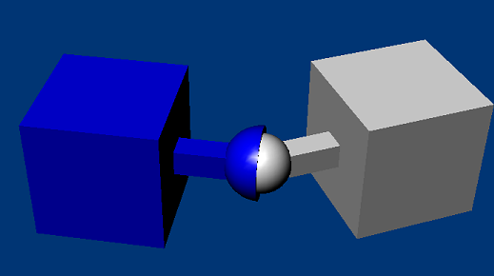
Spherical Joint

Slide 18
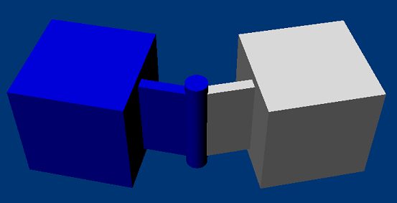
Revolute Joint

Slide 19
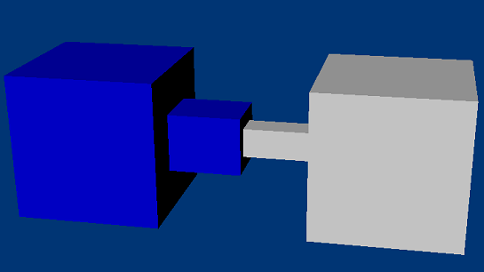
Prismatic Joint

Slide 20
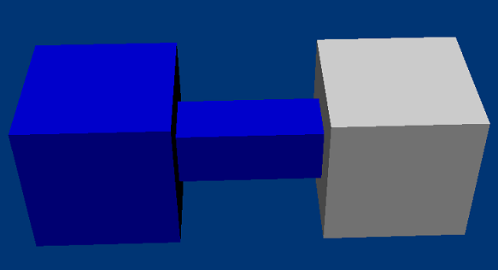
Fixed Joint

Slide 21
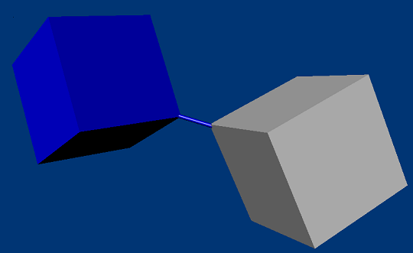
Distance Joint

Slide 22
练习

Slide 23
各种类型的Joint（60分钟时间）
练习范例：201~210
练习要点：
  熟悉各种不同类型Joint的构造方法
  练习过程当中结合前面的理论讲解,掌握具体实现方法
  遇到不理解的先通过练习解决

Slide 24
范例讲解（201）
Joint初始化的注意事项
  Joint的位置
  Joint的轴
如何使用6DOF来模拟fixed Joint
  自由度可以任意设定

Slide 25
212 Joint Limit（30分钟）
练习要点：
  结合前面讲解的Limit理论，在程序中实现
思考：
  如何对一系列Joint赋以不同的Limit来模拟现实中的某些物体
    绳子、人体。。。。。

Slide 26
214 Breakable Joints（30分钟）
练习要点：
  如何使用前面讲解的理论实现可破坏的joint效果
思考：
  发挥创意，利用这一技术做出有意思的效果

Slide 27
问题总结

